Slide 1
FindMyTherapist
Members: Christina Kallas, Sarah Primavera

Slide 2
Project description:
An app so clients can find therapists
Clients can find specialized therapist
Clients can find therapists within their budget
Therapist can upload a profile to be found
Therapist can put up their availability
Therapist may add information such as their price range, type of therapy offered, and platform.

Slide 3
Users:
Client:
Add filters and find therapist
Therapist:
Add their business on the app for clients to find

Slide 4
Database tables:
Therapist(TherapistLicenseNumber(PK), email, password, first name, last name, gender, platform, price range, typeOfTherapyOffered)
Clients (ClientID(PK), email, password, first name, last name, gender, age)
Time slots(timeSlotId(PK),TherapistLicenseNumber(FK), isAvailable, time)
Highlighted items are a maybe

Slide 5
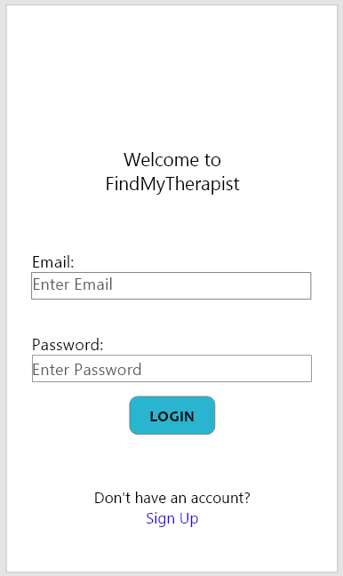
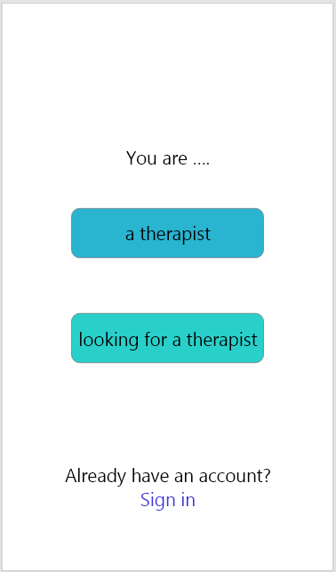
Prototype:
2.2 Client Profile
3.2 Therapist Profile
1.1
1.2
2.1 Client Signup
3.1 Therapist Signup

Slide 6
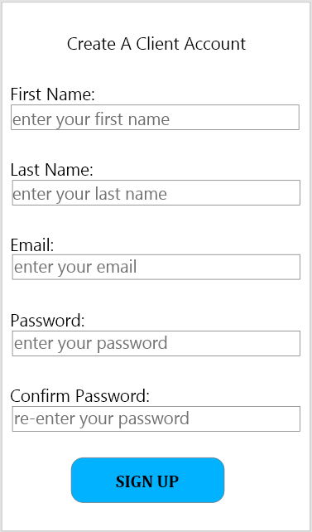
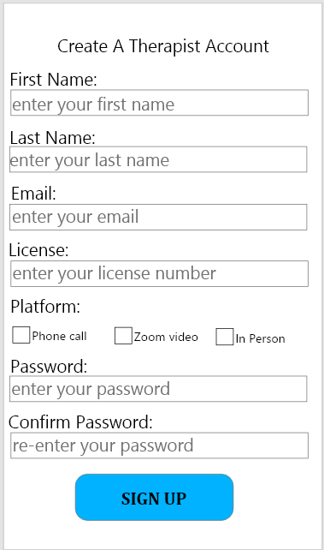
Prototype (continued):
2.1
3.1
3.2 Therapist Profile
2.2 Client Profile

Slide 7
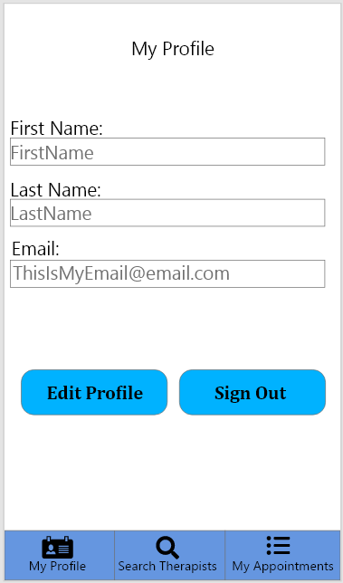
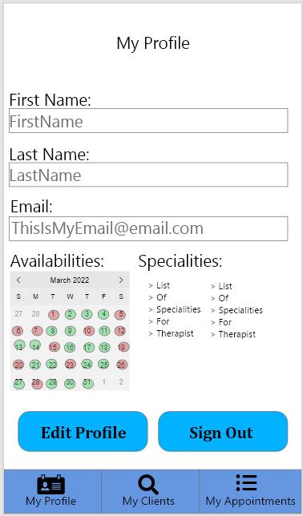
Prototype (continued):
2.2
3.2
4 Sign Out Page
4 Sign Out Page
2.3 Edit Client Profile
3.3 Edit Therapist Profile
3.4 Client Page
2.4 Therapist Search
2.5 Client Appoint-ments
3.5 Therapist Appoint-ments

Slide 8
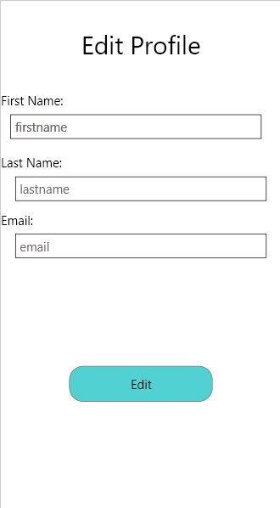
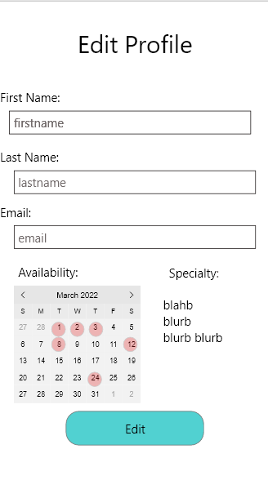
Prototype (continued):
2.3
3.3
2.2 Client Profile
3.2 Therapist Profile

Slide 9
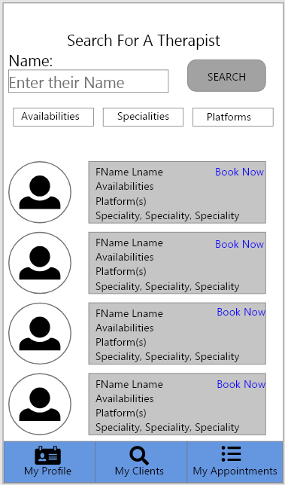
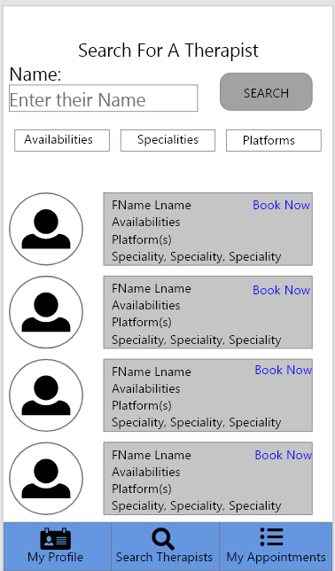
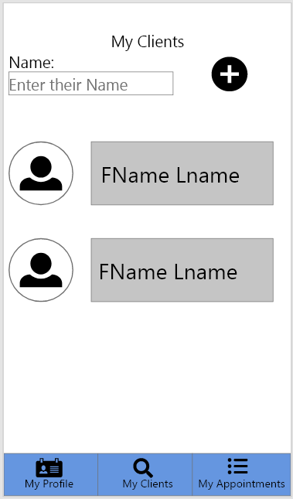
Prototype (continued):
2.4
3.4
3.6 Add Client Page
2.6 Booking Page
3.2 Therapist Profile
2.2 Client Profile
2.5 Client Appoint-ments
3.5 TherapistAppoint-ments

Slide 10
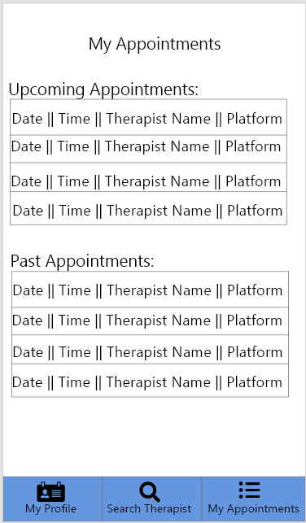
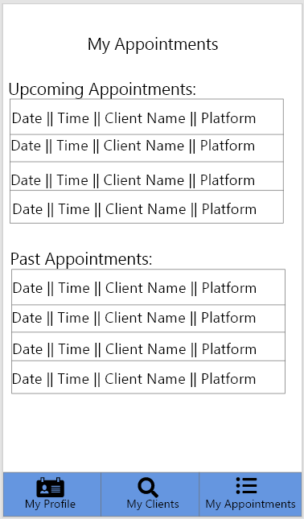
Prototype (continued):
2.5
3.5
2.2 Client Profile
2.2 Therapist Profile
3.4 My Clients page
2.4 Therapist Search

Slide 11
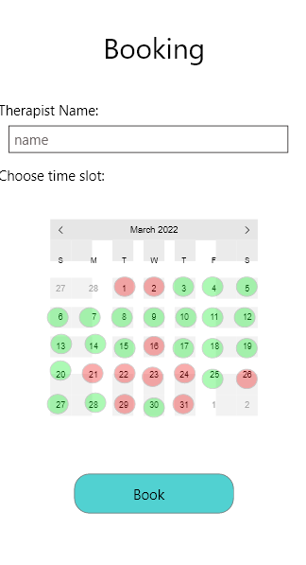
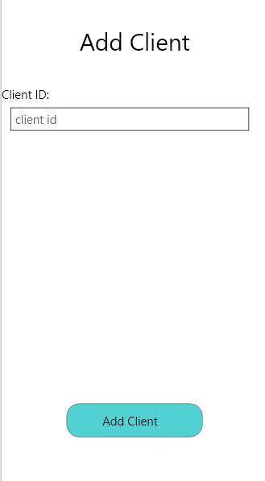
Prototype (continued):
2.6
3.6
When the customer clicks on “book”, the therapist will receive a notification and may click on “accept” or “deny”.
The therapist’s response will then appear as a notification on the
client’s screen. Adding a client is just for their additional information
3.4 My Clients Page
2.4 Therapist Search

Slide 12
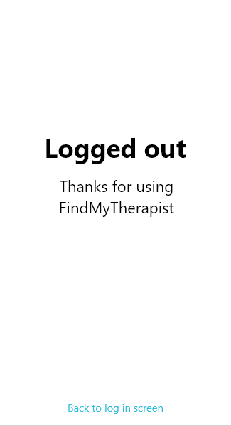
Prototype (continued):
4
1.1 Login Page

Slide 13
Github link:
https://github.com/ChristinaKs/AppDev2TermProject

